Slide 1



-BMCC HUB- Jairo Molina Eddie Ozuna Damiano Canali Myat Thu Ko

Slide 2

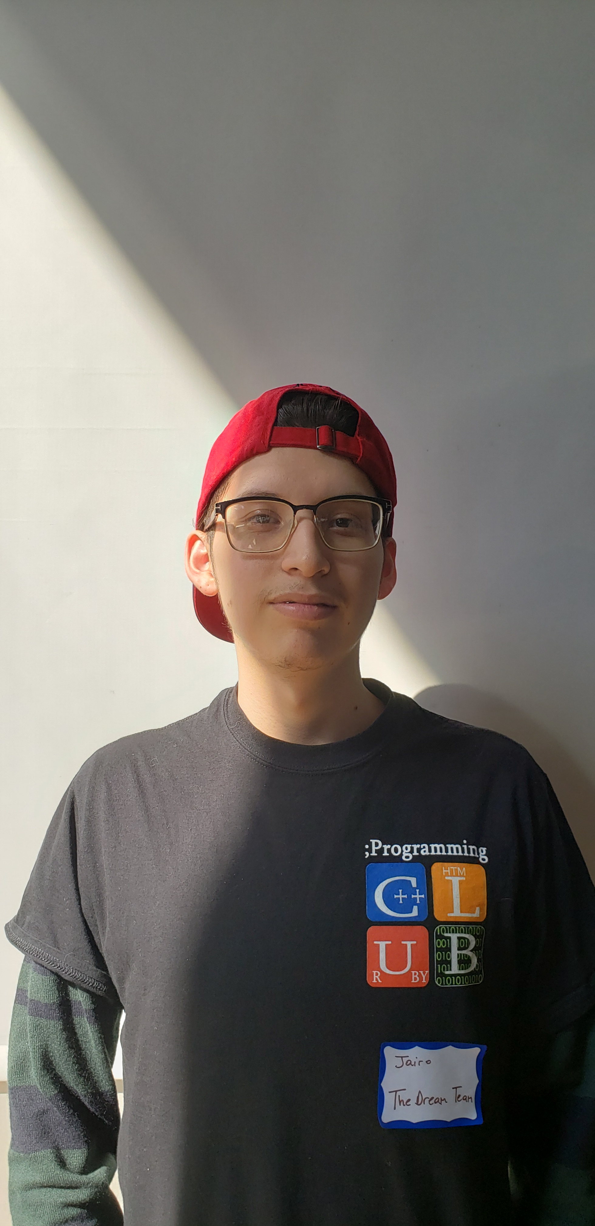
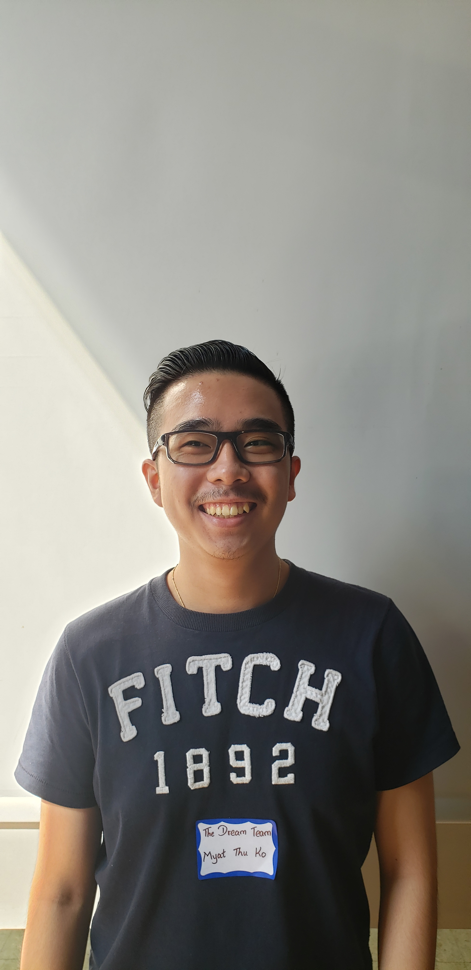
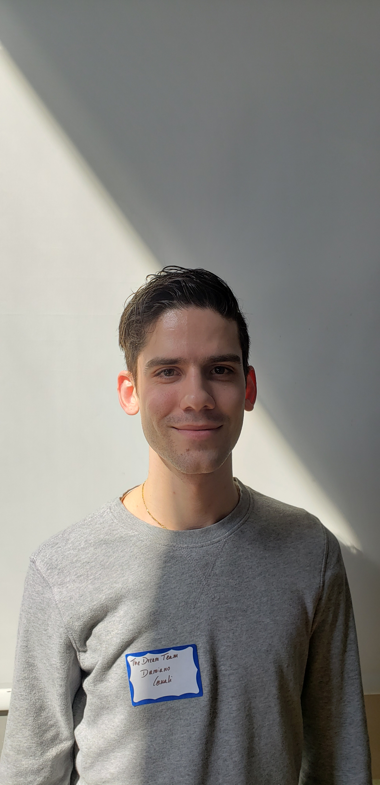
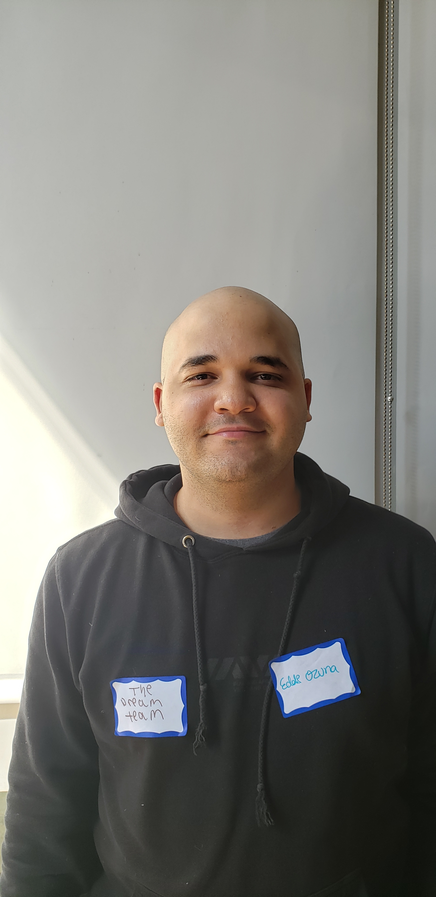
The Dream Team Members:
Molina Jairo, Spain
Ko Myat Thu, Myanmar
Canali Damiano, Italy
Ozuna Eddie, Dom. Republic

Slide 3
Brief description:
Our BMCC Hub Skill will help any student find the location of any office, providing the room number and in which building the office is.
Also, you can ask for an upcoming event, and Alexa will tell you the next event available at BMCC and where to find it.

Slide 4
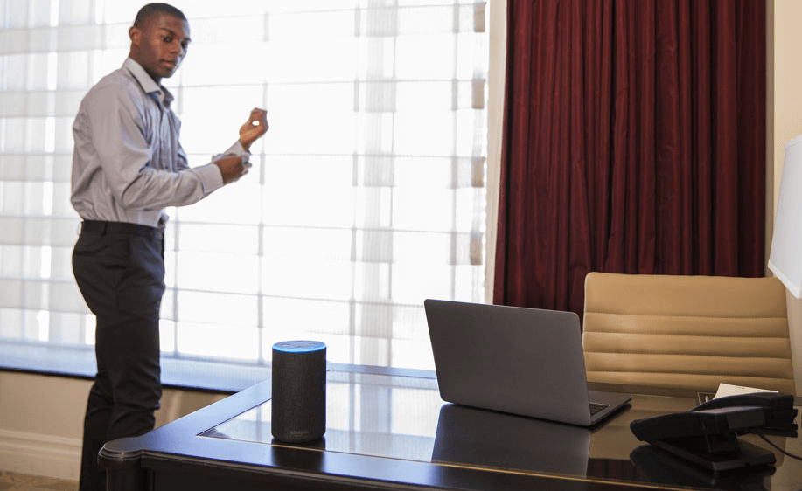
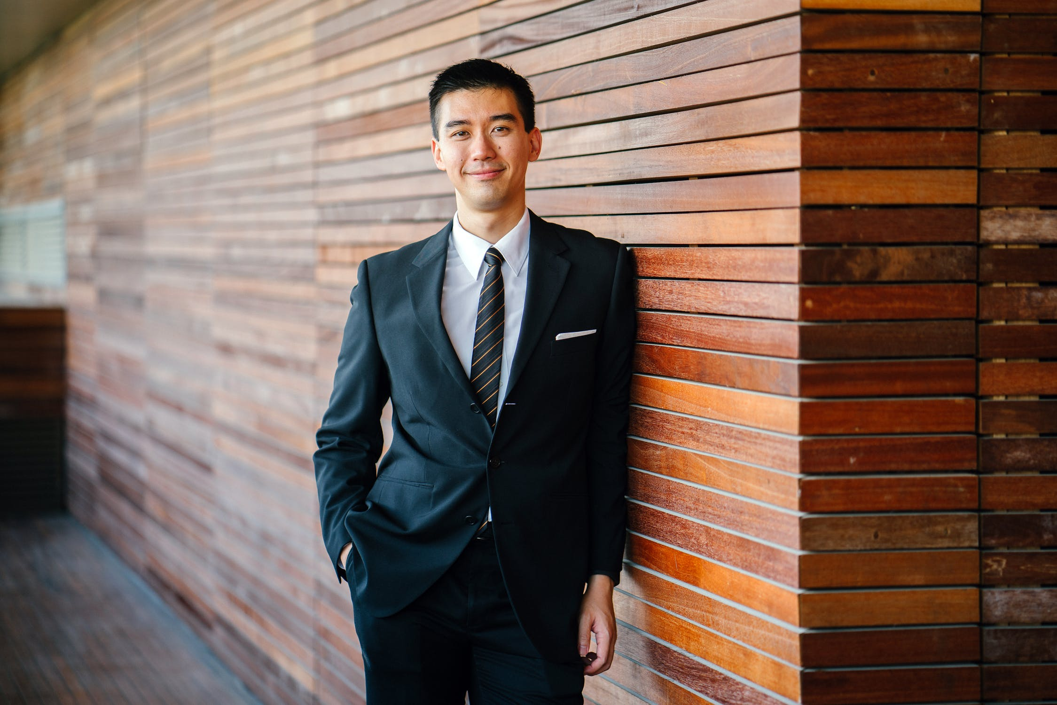
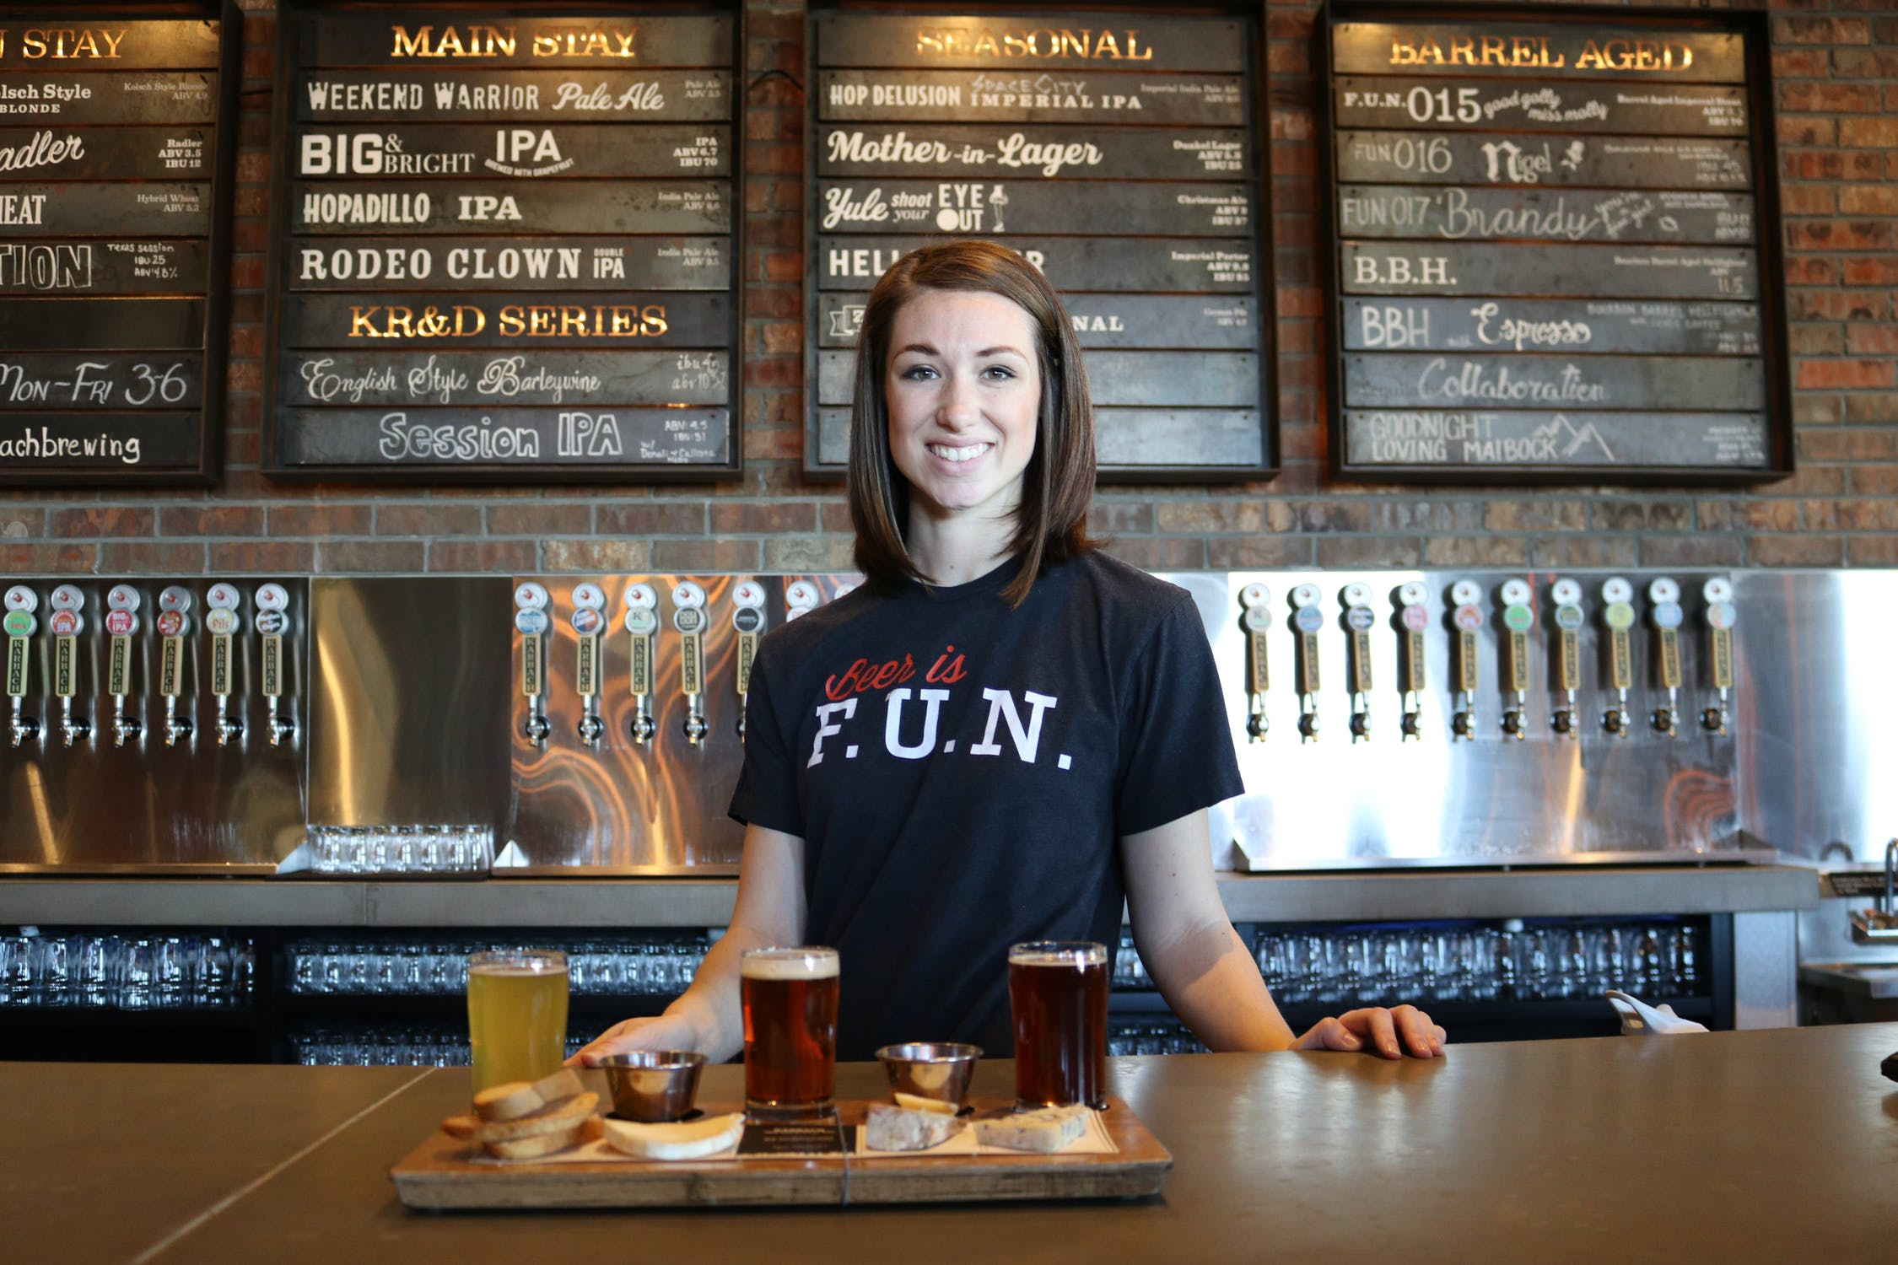
Purpose:
“I never have time to be on my phone"
“I always miss my favorite event!”
“I want to be part of an active college”

Slide 5

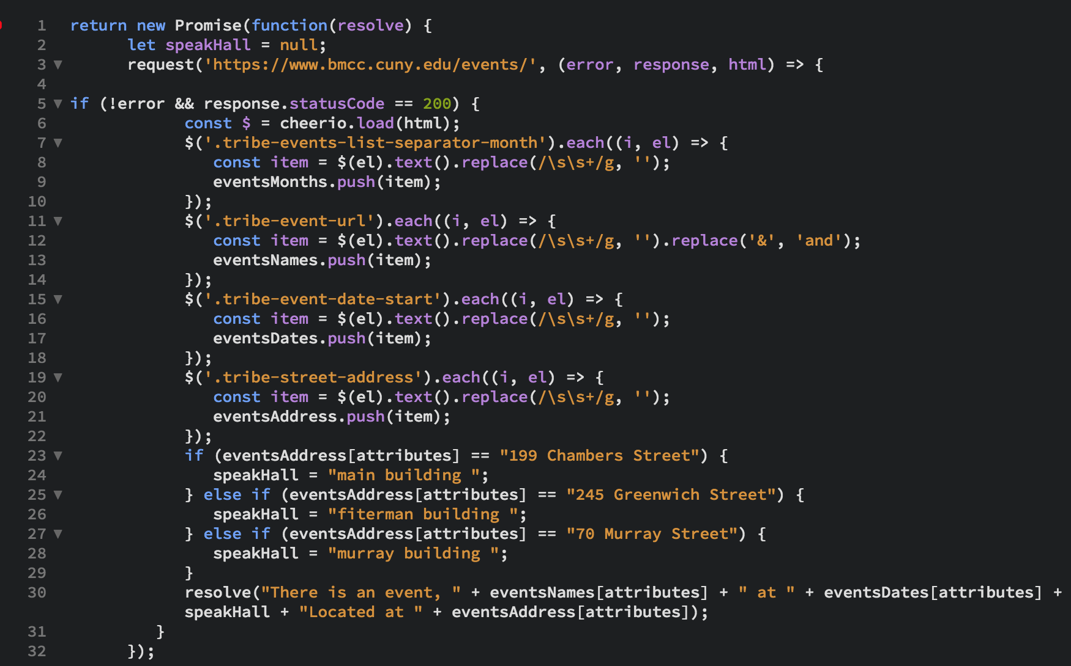

Solution:
https://drive.google.com/open?id=1aUbH-uKkaVvSbZFlNo_3gPZyCyMgX85V

Slide 6



Services:
Use Lambda functions as backend
Utilize the serverless Lambda
Cheerio, request for scrapping
ASK, AWS modules
JSON files for departments information
Utterances, intents, slots efficiently

Slide 7

Future Work:
Database
MySQL and RDS
DynamoDB
Events
Search for specific events
Filter events
Interaction
Decrease time intervals
Sustainable data

Slide 8
Thank You All
The Dream Team
BMCC HACKATHON 2019

